Slide 1
EDA Analysis Beer and Breweries Budweiser
Presented by: Carlos Estevez and Haitie Liu

Slide 2
Objectives
Introduction
History of Budweiser
Definition of IBU and ABV
Difference between IPA and PALE
Lagers and Ale
Style of beers
List of KPI

Slide 3
Introduction
In this EDA(Exploratory Data Analysis) we will conduct an analysis about the beers sold by Budweiser across different states in the United States. In addition, we will also show the different beer’s styles managed by each brewery in each state which will give us a glimpse about the assortment breath of every Beer store
The whole idea of this analysis is to focus on the different business areas that the Budweiser corporation could improve in terms of customer service and stock availability
We will analyze and investigate data sets and summarize their main characteristics, often employing data visualization methods to be more compressive. Our main goal will be to recognize the areas where the company can focus aiming to strengthen their position in the market and ultimately translate these benefits to the final customer
Before moving on the data analytics we need to understand different concepts about the beers and how he business really works. We will star off by giving a short overview of the company’s history
To make the analysis more readily to the audience we will explain different concepts necessary to understand the KPI we will present. Concepts like: IBU, PALE, ABV and Lager will be explained

Slide 4
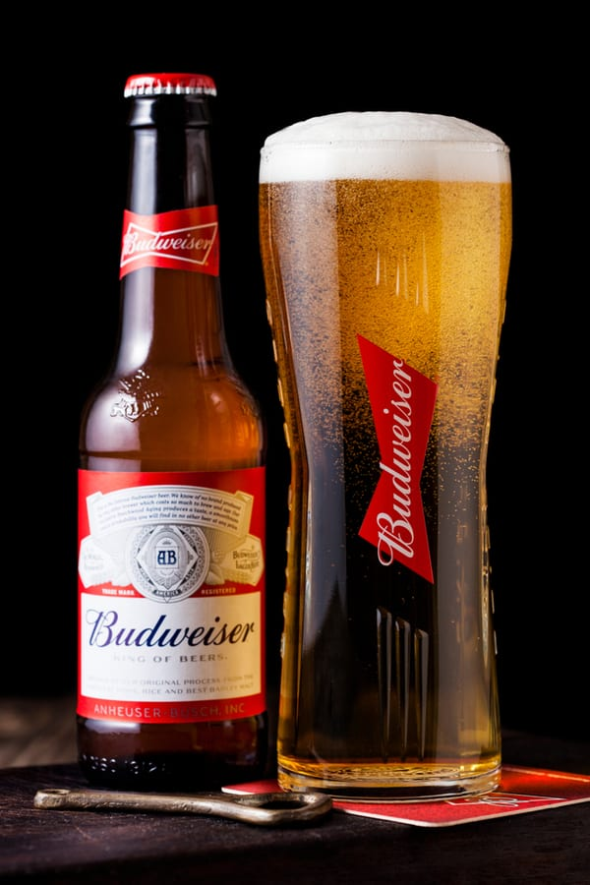
History
Budweiser is an American Lager beer made with two-row and six-row wheat in addition to rice
The Budweiser founder was Adolphus Busch, a German immigrant who came to St. Louis, Missouri, in 1857. In those times, Americans were mostly drinking heavy, dark ales, but this man decided to change that habit by creating refreshing light lager perfect for hot summers
Based on the Beer Judge Certification Program (which categorizes beers based on several factors), Budweiser is classified as an American lager, a sub-category of the general category of standard US beers
Image 1: Budweiser beer

Slide 5
IBU and ABV
The types of beer can be broken down into hundreds of different styles, all with unique flavors, colors, and aromas. Two characteristics that are used to describe styles of beer are alcohol by volume (ABV) and international bitterness unit (IBU)
ABV stands for alcohol by volume and represents the percentage of alcohol in the beer. The amount of alcohol in the brew can actually affect the taste of the beer. Beers with a higher ABV have a more bitter flavor. In very strong beers, the alcohol can numb the tongue and neutralize the taste, so additional flavors are added to compensate. Brewers use ABV to achieve the perfect balance between sweetness and bitterness
IBU stands for international bitterness unit and is a measurement of the number of bitter flavor compounds in a beer. The IBU scale starts at zero and has no upper limit, but most beers fall between 5 IBUs and 120 IBUs. Anything higher than 120 can't be detected by the average palate

Slide 6
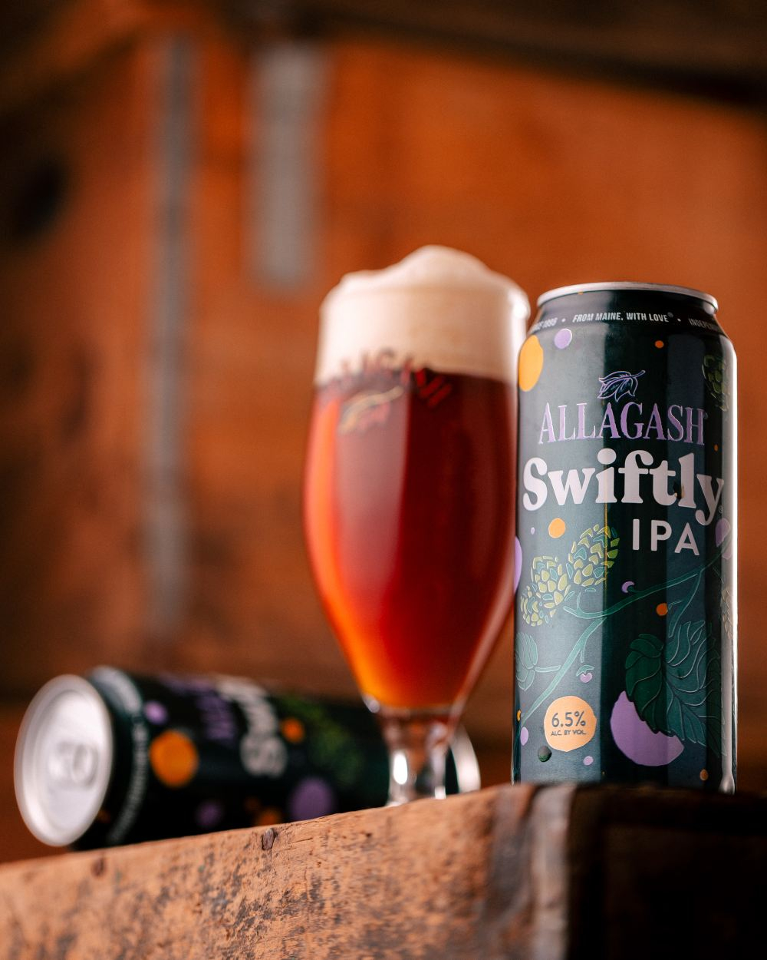
IPA and PALE
Pale ale and IPA (historically called India Pale Ale) are two of the most well-known beer styles. Despite similar names, in reality they are part of an extremely diverse group in the pale ale family that have significant overlapping characteristics
Generally speaking, the main differences between pale ale and IPA is that IPAs will have bigger hop flavors and slightly higher ABV (alcohol by volume). Pale ales will usually be between 4.5 – 6.2% ABV, where IPAs will usually sit somewhere between 5 – 7.5% (or more for a double IPA, 7.5 – 10.0%)
When it comes down to it, a Pale Ale should have a nice hop character but medium build, whereas IPAs tend to have higher ABV and IBU
Image 1: Budweiser beer

Slide 7
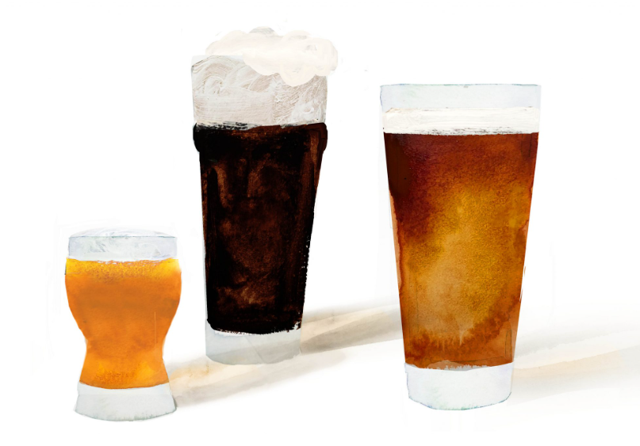
ALE and Lagers
All beer falls into two styles: ales and lagers. Yeast is the difference here. In lagers (saccharomyces pastorianus), yeast gathers at the bottom of the tank during fermentation
Lagers are usually crisp, clean and refreshing. With ales (saccharomyces cerevisiae), the yeast gathers toward the top. These beers are aromatic and often fruity
Another difference is timing and temperature. Ales age for just a few weeks at around 40–55°F, while lagers can age for months between 32–45°F.
Image 1: Budweiser beer

Slide 8
List of KPI
How many breweries are present in each state
Merge beer data with the breweries data
Address the missing values in each column
Compute the median alcohol content and international bitterness unit for each state. Plot a bar chart to compare
Which state has the maximum alcoholic (ABV) beer? Which state has the most bitter (IBU) beer?
Comment on the summary statistics and distribution of the ABV variable
Is there an apparent relationship between the bitterness of the beer and its alcoholic content? Draw a scatter plot. Make your best judgment of a relationship and EXPLAIN your answer
Budweiser would also like to investigate the difference with respect to IBU and ABV between IPAs (India Pale Ales) and other types of Ale (any beer with “Ale” in its name other than IPA)
Knock their socks off! Find one other useful inference from the data that you feel Budweiser may be able to find value in. You must convince them why it is important and back up your conviction with appropriate statistical evidence

Slide 9
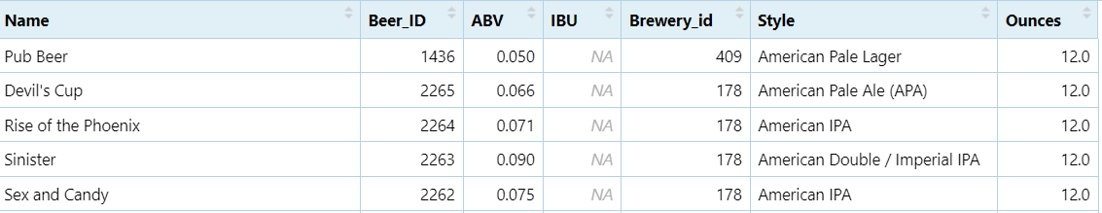
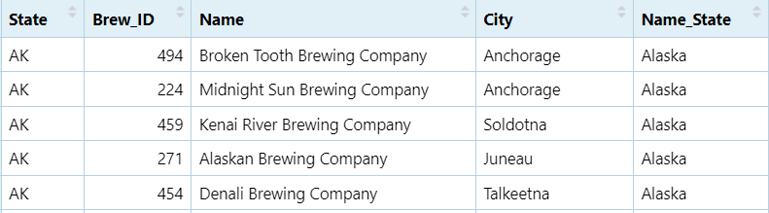
Datasets
We have two datasets as a source of information
Df_Beers: Beers.csv
Df_Breweries: Breweries.csv

Slide 10

3.Analysis of missing values
Data Cleaning is one of the important steps in EDA. Data cleaning can be done in many ways. One of them is handling missing values
A missing value can be defined as the data value that is not captured nor stored for a variable in the observation of interest. There are 3 types of missing values
DF_Beers
ABV:62 missing values
IBU: 1005 missing values
We will use different different approaches to deal with the missing values in our dataset(DF_Beers)
ABV→Replacing missing values using Mean
IBU→Replacing missing values using KnnImputation
KnnImputer utilizes the k-Nearest Neighbors method to replace the missing values in the datasets with the mean value from the parameter ‘n_neighbors’ nearest neighbors found in the training set
Image 1: Data Cleansing

Slide 11
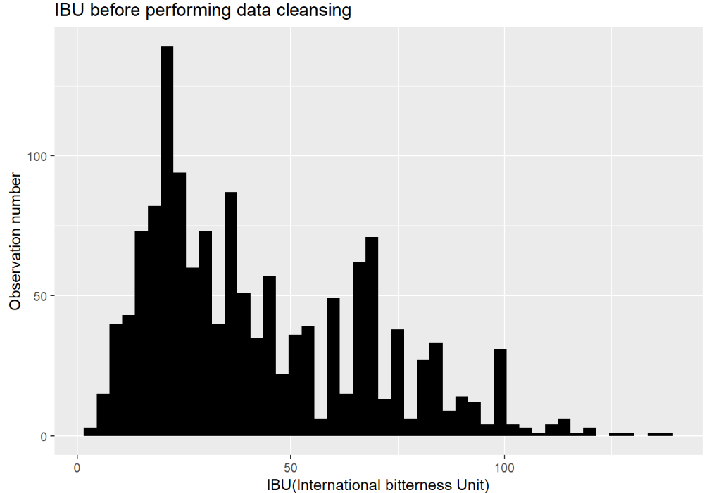
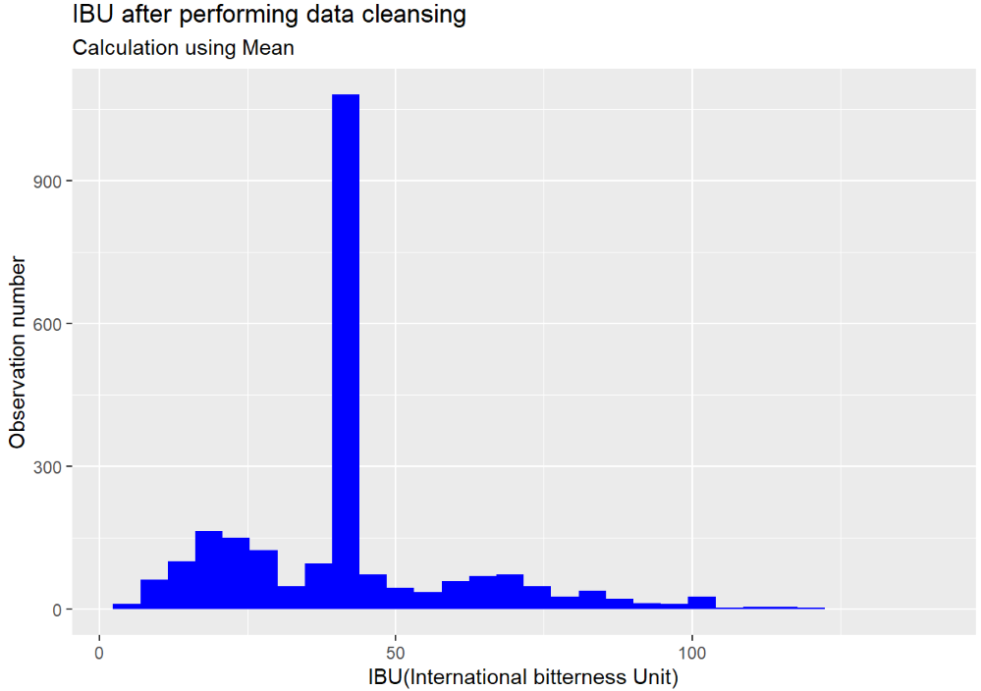
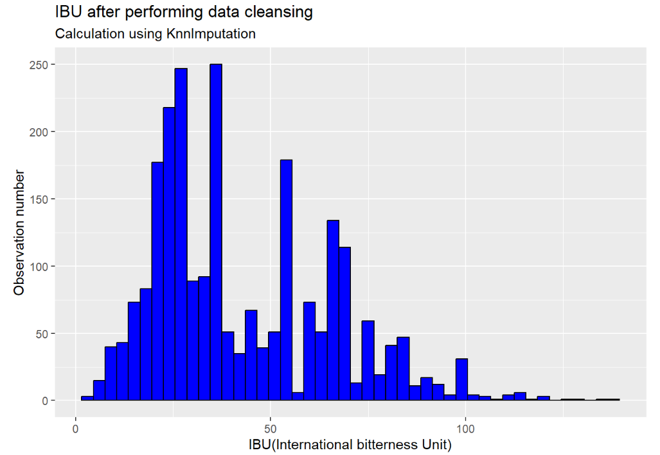
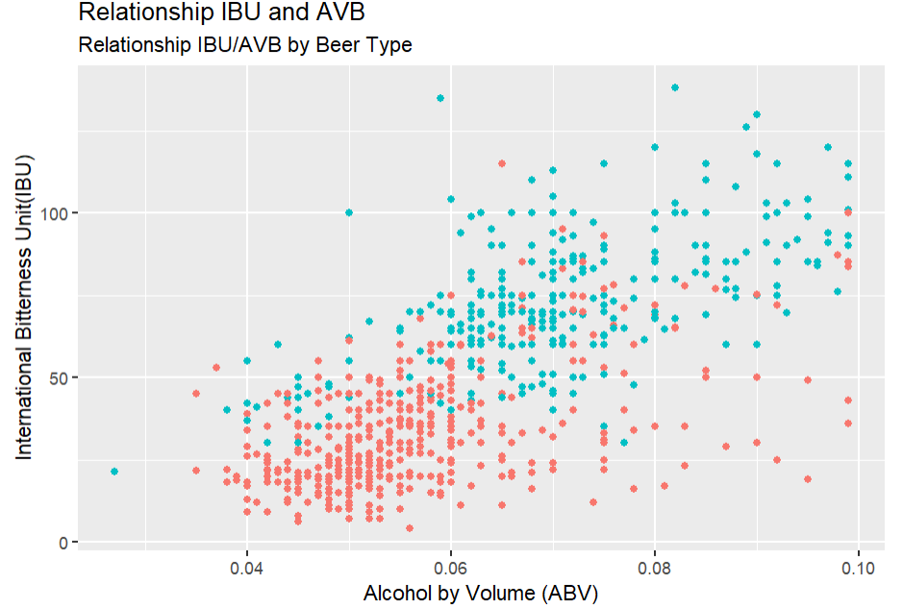
3.Analysis of missing values
IBU Replacing missing values
There are a large number missing observations when it comes to IBU. We need to find a sophisticated method to deal with this problem. If we tried to ignore these observations, that will be a bad idea since we will lose half of the dataset
If we try to replace them with the Mean as we did with ABV it will be also a terrible idea. Look at blue plot
The idea in kNN methods is to identify ‘k’ samples in the dataset that are similar or close in the space. Then we use these ‘k’ samples to estimate the value of the missing data points
It is important that we find a relationship between IBU with another variable in the dataset. We think IBU and ABV are related
The final results look very good when we compare the resulting distribution with the original
Bad idea
Great

Slide 12
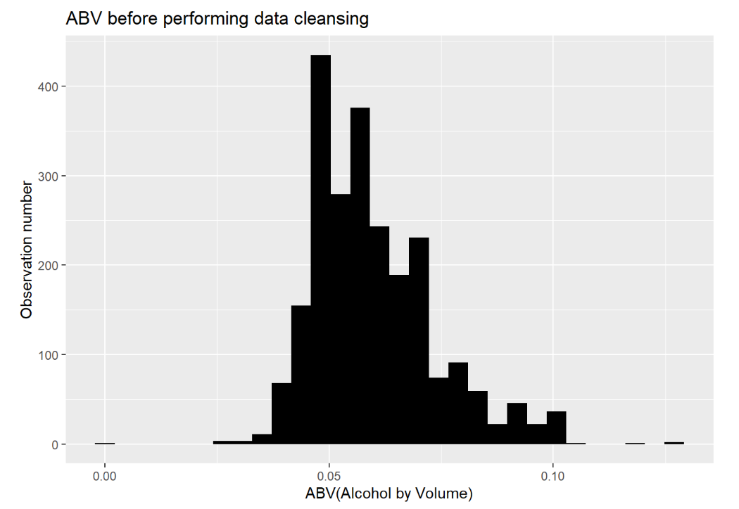
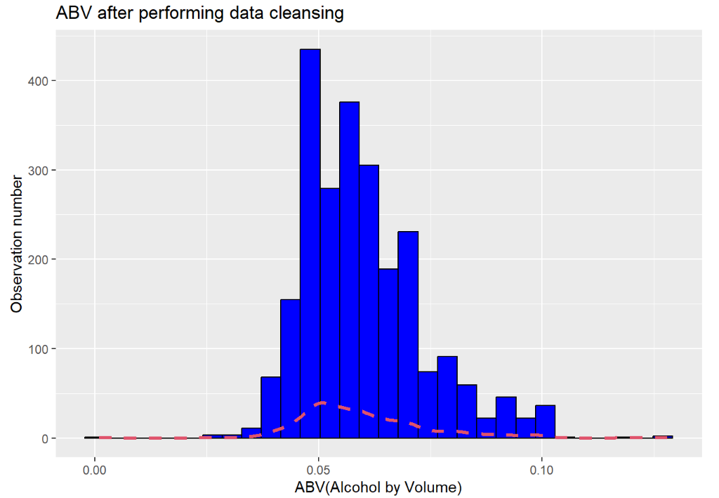
3.Analysis of missing values
ABV Replacing missing values
To tackle missing values for ABV with opted for replacing these missing observation with the arithmetic mean
Resulting dataset

Slide 13
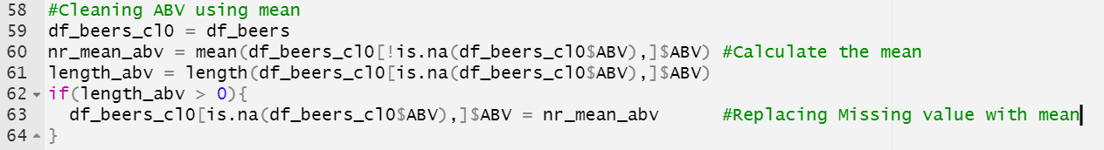
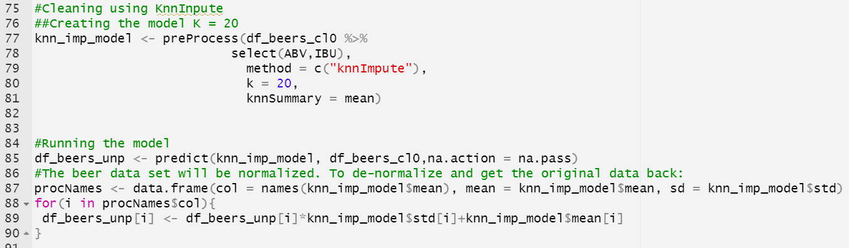
3.Analysis of missing values
Source Code IBU and ABV Data Cleansing
ABV data cleansing: Replacing missing value with mean
IBU Data Cleansing: Using KNN Imputation
Initializing the model
Running the model
De-Normalizing data

Slide 14
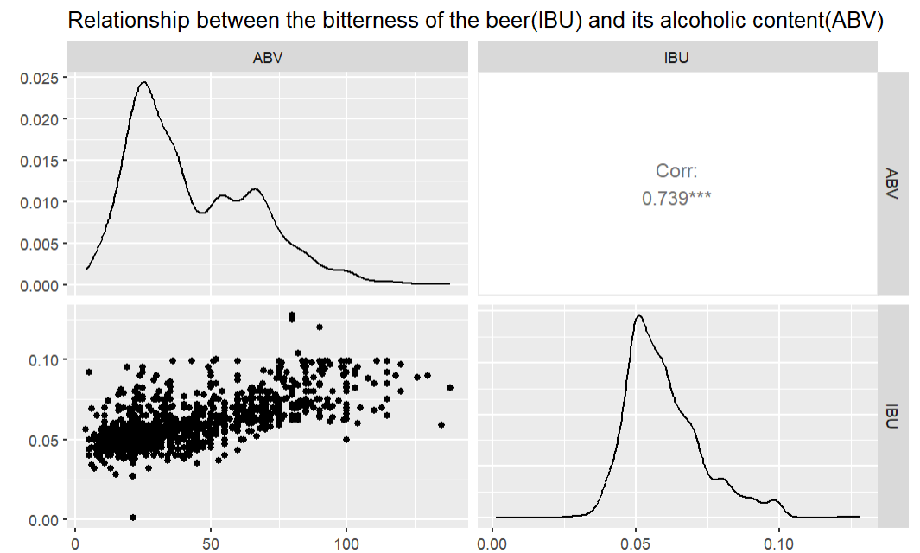
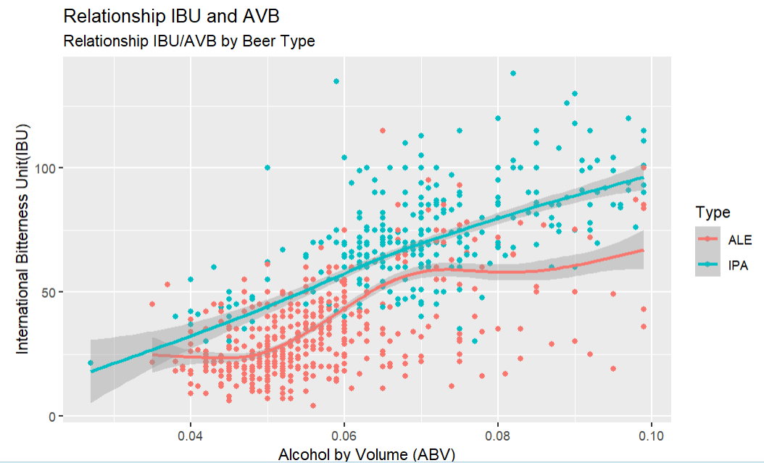
7.Relationship between IBU and ABV
Relationship between IBU and ABV
As the data suggests there’s a positive linear relationship between IBU and ABV. As ABV increases so does IBU
At the beginning of the document we presented this information from the Budweiser website: “When it comes down to it, a Pale Ale should have a nice hop character but medium build, whereas IPAs tend to have higher ABV and IBU”
This last statement complements what the data is reflecting. IBU and ABV are proportionally related
The correlation coefficient also confirms the linear relationship

Slide 15
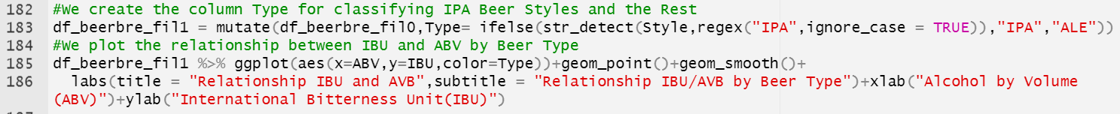
7.Relationship between IBU and ABV
Source Code
Using Ggpair to plot the relationship between both variables
Scatterplot using geom_point
To determine the classification of the beer we used Regular expression by evaluating the value of the column Style
We plot the data

Slide 16
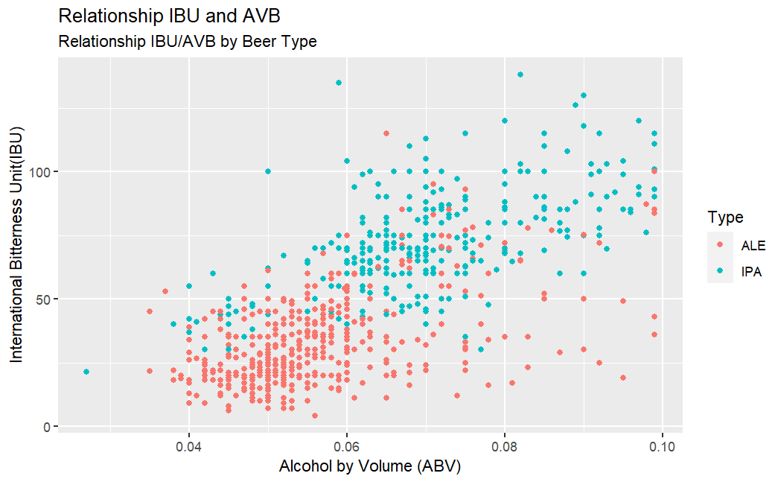
8.Difference between IPA and PALE Beer types
As we can see from the image the observations of the IPA beer types have higher level of bitterness and alcohol
And the opposite is also true. The ALE Beer Types have less level of IBU and ABV
At the beginning of the presentation we also highlighted the differences between ALE and IPA.
“Pale ales will usually be between 4.5 – 6.2% ABV, where IPAs will usually sit somewhere between 5 – 7.5% (or more for a double IPA, 7.5 – 10.0%). IPAs may also be slightly more bitter, but there is a wide range here”
We also can use KNN to verify that this is true

Slide 17
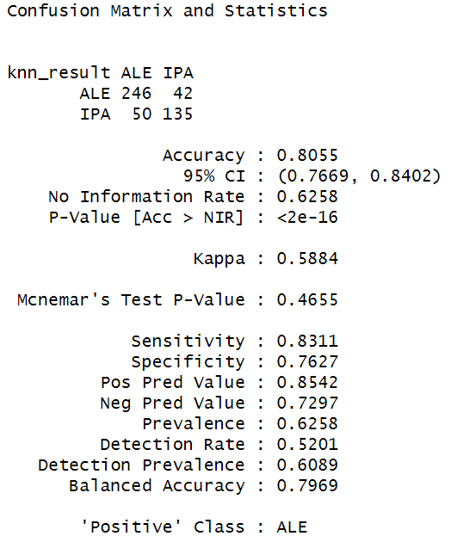
8.Difference between IPA and PALE Beer types
KNN Results
As we can see from the image, the accuracy of KNN is very high, almost 80%. That means there’s a clear difference between IPA beers and the rest
Giving the fact that KNN showed a high accuracy using IBU and ABV, all it means that KNN easily can classify when a beer is IPA or a beer is a Pale . In that sense, both group have a clear difference when it comes to the level of bitterness and alcohol, and KNN could easily identified this difference

Slide 18
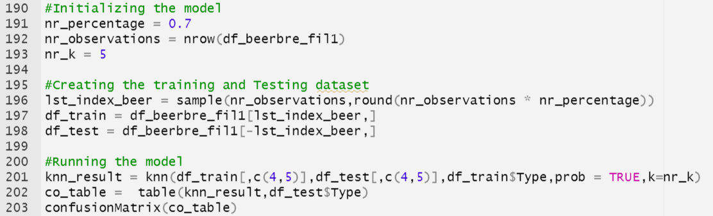
8.Difference between IPA and PALE Beer types
Source Code
Selecting K
Creating training and testing dataset
Initializing the model
Running the model
Creating confusion matrix

Slide 19
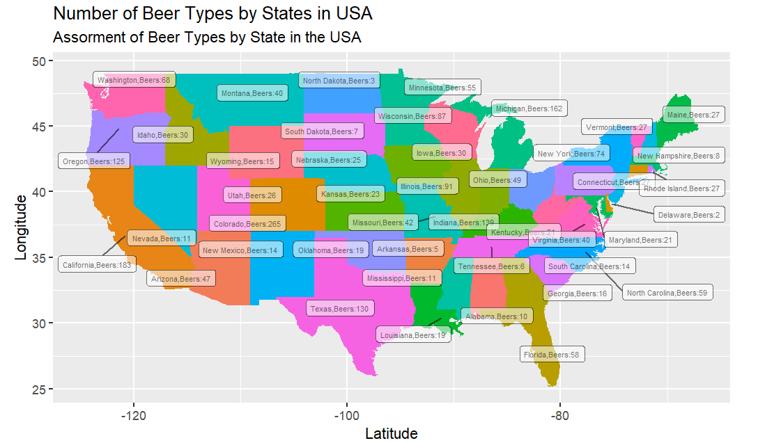
9.Analysis of Beer Assortment by State

Slide 20
9.Analysis of Beer Assortment by State
Comments
The map shows the information about the number of beers or SKU by state in the United States
For example we can notice that state such as California has a large number of beers by style 183 and states like Dakota has only 3 beers by style
This data will play an important role in two different areas:
Advertising strategy
Inventory management
It is a great idea to invest capital in advertising strategy in states like California and Colorado because of the level of consumption of beer. We don’t have selling information however, we can notice by the wide assortment of California that the demand of beer is really high and more importantly the customers are willing to purchase more style of beers. On the other side, it doesn’t make sense to invest too much money in States like Dakota because it seems that demand of beers is very low.
In terms of Inventory Management, it is recommendable to keep a high service level and a good safety stock in states like California or Colorado aiming to provide a great customer service. We have to prevent getting stock out in those states since it seems they bring the most profit to the company

Slide 21
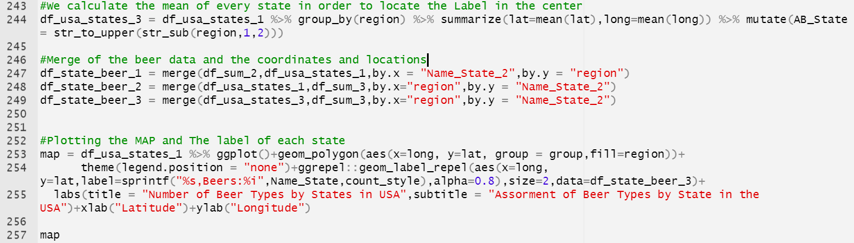
9.Analysis of Beer Assortment by State
Source code
We calculate the mean of the latituted and longitude in order to locate the label in the center of the state
We join two data frame: Beer data and geographic data
We plot the MAP using the function geom_polygon
We also used geom_label_repel to position the label. This function is better than geom_text since it will manage better when two text overlap

Slide 22
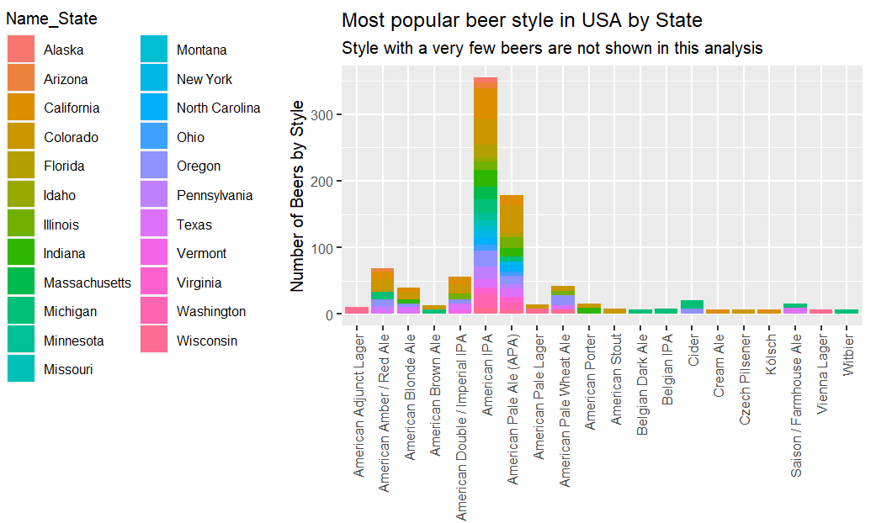
9.Analysis of Beer Assortment by State

Slide 23
9.Analysis of Beer Assortment by State
Comments
The image shows the number of beer by style in each state
This plot is very meaningful, because it give us an idea about the most popular beer styles in every state in USA. As a result, the company can focus on these beer styles in the future in order to increase production for these skus

Slide 24
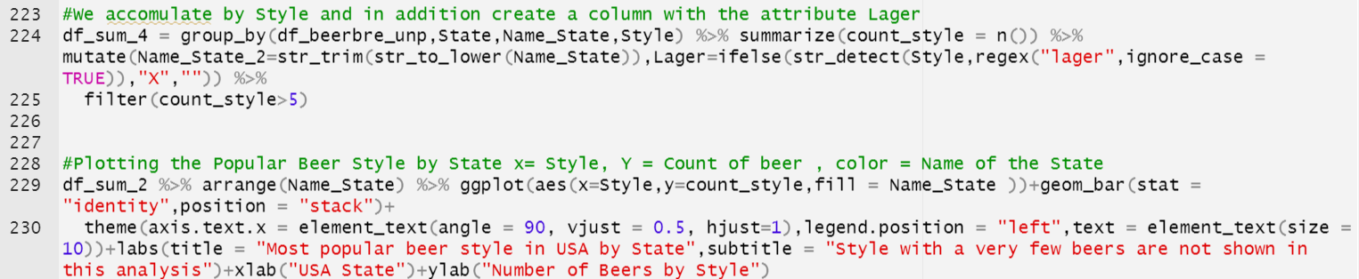
9.Analysis of Beer Assortment by State
Source code
We calculate the most popular beer styles by only considering styles with more than five beers
We plot the data with geom_bar using the previus dataframe

